Slide 1

CSE 591 Hierarchical Clustering and Visualization
Ross Maciejewski
rmacieje@asu.edu

Slide 2
Hierarchical Clustering
Produces a set of nested clusters organized as a hierarchical tree
Can be visualized as a dendrogram (along with other options)
A tree-like diagram that records the sequences of merges or splits

Slide 3
Strengths of Hierarchical Clustering
No assumptions on the number of clusters
Any desired number of clusters can be obtained by ‘cutting’ the dendogram at the proper level
Hierarchical clusterings may correspond to meaningful taxonomies
Example in biological sciences (e.g., phylogeny reconstruction, etc), web (e.g., product catalogs) etc

Slide 4
Hierarchical Clustering
Two main types of hierarchical clustering
Agglomerative:
Start with the points as individual clusters
At each step, merge the closest pair of clusters until only one cluster (or k clusters) left
Divisive:
Start with one, all-inclusive cluster
At each step, split a cluster until each cluster contains a point (or there are k clusters)
Traditional hierarchical algorithms use a similarity or distance matrix
Merge or split one cluster at a time

Slide 5
Complexity of hierarchical clustering
Distance matrix is used for deciding which clusters to merge/split
At least quadratic in the number of data points
Not usable for large datasets

Slide 6
Agglomerative clustering algorithm
Most popular hierarchical clustering technique
Basic algorithm
Compute the distance matrix between the input data points
Let each data point be a cluster
Repeat
Merge the two closest clusters
Update the distance matrix
Until only a single cluster remains
Key operation is the computation of the distance between two clusters
Different definitions of the distance between clusters lead to different algorithms

Slide 7
Input/ Initial setting
Start with clusters of individual points and a distance/proximity matrix
p1
p2
p3
p4
p5
. . .
p1
p2
p3
p4
p5
.
.
.
Distance/Proximity Matrix

Slide 8
Intermediate State
After some merging steps, we have some clusters
C1
C2
C3
C4
C5
C1
C2
C3
C3
C4
C4
C5
C1
Distance/Proximity Matrix
C2
C5

Slide 9
Intermediate State
Merge the two closest clusters (C2 and C5) and update the distance matrix.
C1
C2
C3
C4
C5
C1
C3
C2
C4
C3
C4
C5
C1
Distance/Proximity Matrix
C2
C5

Slide 10
After Merging
“How do we update the distance matrix?”
C2 U C5
C1
C3
C4
C3
C1
?
C4
C2 U C5
? ? ? ?
C3
?
C1
C4
?
C2 U C5

Slide 11
Distance between two clusters
Each cluster is a set of points
How do we define distance between two sets of points
Lots of alternatives
Not an easy task

Slide 12
Distance between two clusters
Single-link distance between clusters C_{i} and C_{j} is the minimum distance between any object in C_{i} and any object in C_{j}
The distance is defined by the two most similar objects

Slide 13
Single-link clustering: example
Determined by one pair of points, i.e., by one link in the proximity graph.
1
2
3
4
5

Slide 14
Single-Link Clustering Example
5
1
3
5
2
1
2
3
6
4
4
Nested Clusters
Dendrogram

Slide 15
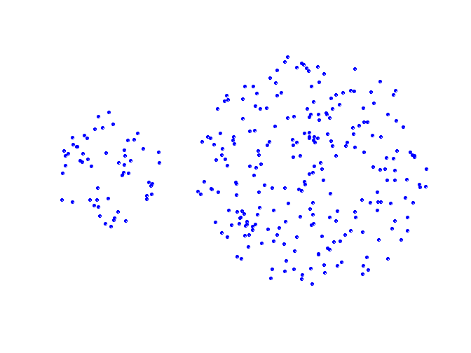
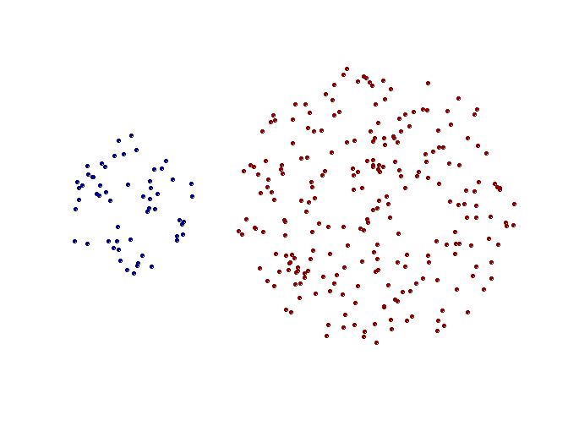
Strengths of Single-Link Clustering
Original Points
Two Clusters
Can handle non-elliptical shapes

Slide 16
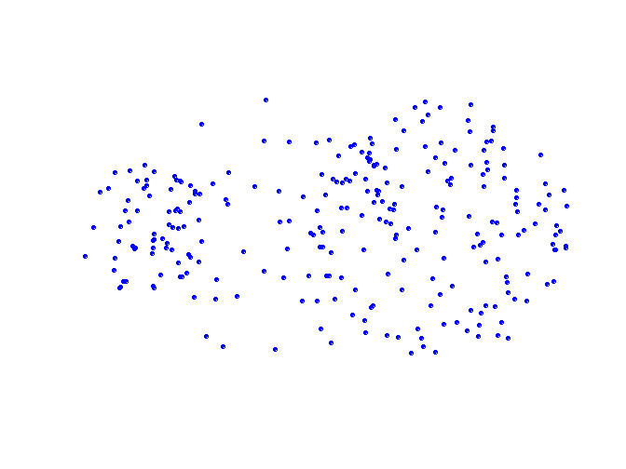
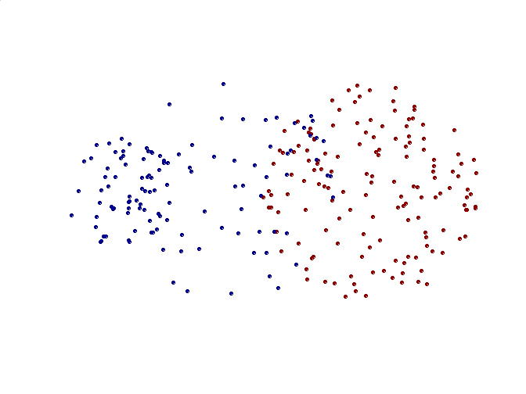
Limitations of Single-Link Clustering
Original Points
Two Clusters
Sensitive to noise and outliers
It produces long, elongated clusters

Slide 17
Distance between two clusters
Complete-link distance between clusters C_{i} and C_{j} is the maximum distance between any object in C_{i} and any object in C_{j}
The distance is defined by the two most dissimilar objects

Slide 18
Complete-link clustering: example
Distance between clusters is determined by the two most distant points in the different clusters
1
2
3
4
5

Slide 19
Complete-Link Clustering Example
4
1
2
5
5
2
3
6
3
1
4
Nested Clusters
Dendrogram

Slide 20
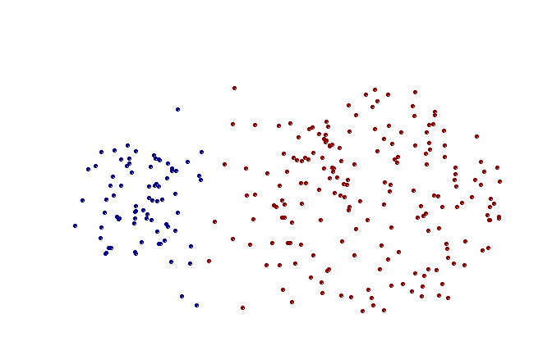
Strengths of complete-link clustering
Original Points
Two Clusters
More balanced clusters (with equal diameter)
Less susceptible to noise

Slide 21
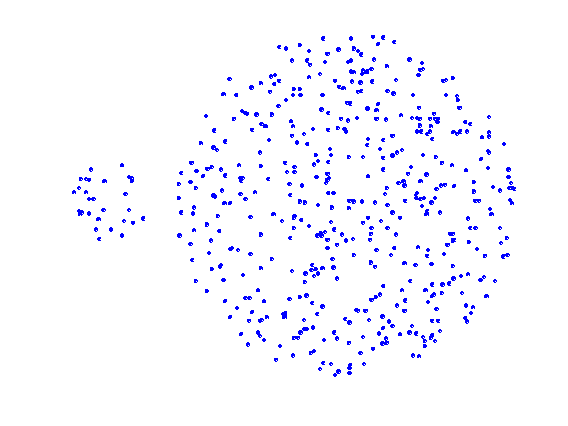
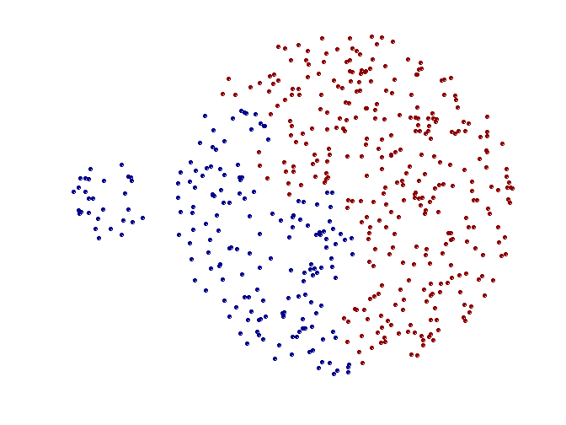
Limitations of Complete-Link Clustering
Original Points
Two Clusters
Tends to break large clusters
All clusters tend to have the same diameter – small clusters are merged with larger ones

Slide 22
Distance between two clusters
Group average distance between clusters C_{i} and C_{j} is the average distance between any object in C_{i} and any object in C_{j}

Slide 23
Average-link clustering: example
Proximity of two clusters is the average of pairwise proximity between points in the two clusters.
1
2
3
4
5

Slide 24
Average-Link Clustering Example
5
4
1
2
5
2
3
6
1
4
3
Nested Clusters
Dendrogram

Slide 25
Average-link clustering: discussion
Compromise between Single and Complete Link
Strengths
Less susceptible to noise and outliers
Limitations
Biased towards globular clusters

Slide 26
Distance between two clusters
Centroid distance between clusters C_{i} and C_{j} is the distance between the centroid r_{i} of C_{i} and the centroid r_{j} of C_{j}

Slide 27
Distance between two clusters
Ward’s distance between clusters C_{i} and C_{j} is the difference between the total within cluster sum of squares for the two clusters separately, and the within cluster sum of squares resulting from merging the two clusters in cluster C_{ij}
r_{i}: centroid of C_{i}
r_{j}: centroid of C_{j}
r_{ij}: centroid of C_{ij}

Slide 28
Ward’s distance for clusters
Similar to group average and centroid distance
Less susceptible to noise and outliers
Biased towards globular clusters
Hierarchical analogue of k-means
Can be used to initialize k-means

Slide 29
Hierarchical Clustering: Comparison
5
1
4
1
3
2
5
5
5
2
1
MIN
2
MAX
2
3
6
3
3
6
1
4
4
4
5
5
1
4
1
2
2
5
2
Ward’s Method
5
2
3
6
Group Average
3
3
6
4
1
1
4
4
3

Slide 30
Hierarchical Clustering: Time and Space requirements
For a dataset X consisting of n points
O(n²) space; it requires storing the distance matrix
O(n³) time in most of the cases
There are n steps and at each step the size n² distance matrix must be updated and searched
Complexity can be reduced to O(n² log(n) ) time for some approaches by using appropriate data structures

Slide 31
Hierarchical Clustering Issues
Distinct clusters are not produced – sometimes this can be good, if the data has a hierarchical structure w/o clear boundaries
There are methods for producing distinct clusters, but these usually involve specifying somewhat arbitrary cutoff values
What if data doesn’t have a hierarchical structure? Is HC appropriate?

Slide 32
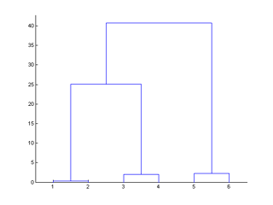
Leaf Ordering in HC
The order of the leaves (data points) is arbitrary in Eisen’s implementation
If we have n data points, this leads to 2^{n-1} possible orderings
Eisen claims that computing an optimal ordering is impractical, but he is wrong…

Slide 33
Optimal Leaf Ordering
Z. Bar-Joseph et al., Fast optimal leaf ordering for hierarchical clustering, ISMB 2001.
Idea is to arrange leaves so that the most similar ones are next to each other
Algorithm is practical (runs in minutes to a few hours on large expression data sets)

Slide 34
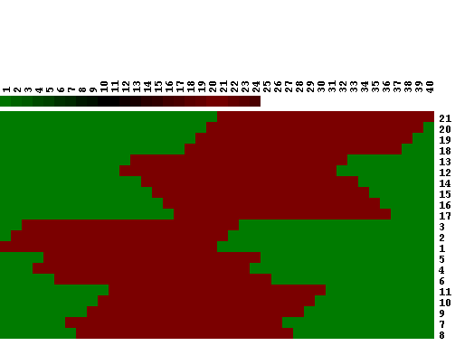
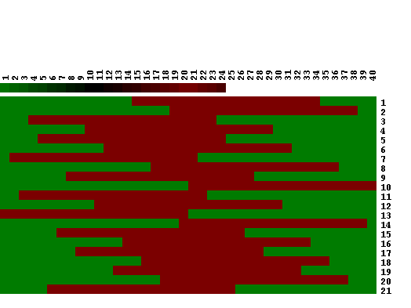
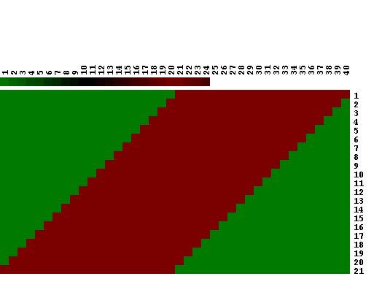
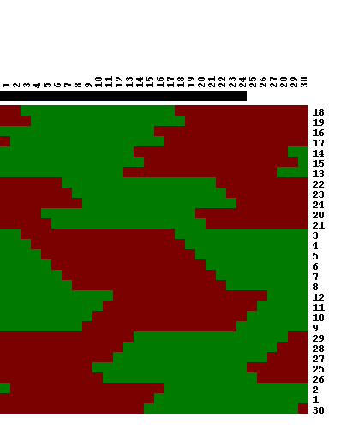
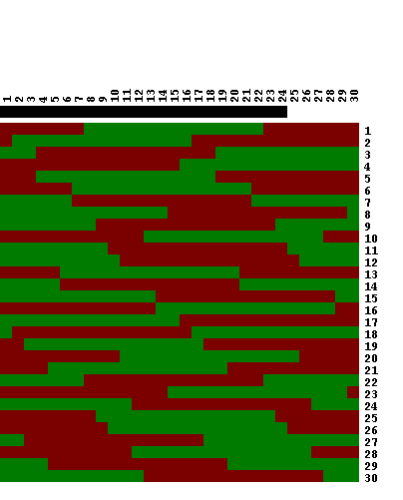
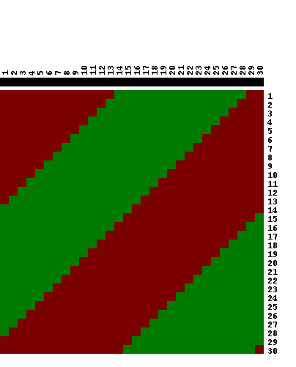
Optimal Ordering Results
Hierarchical clustering
Input
Optimal ordering
Hierarchical clustering
Input
Optimal ordering

Slide 35
Hierarchical Clustering Explorer
Multidimensional data sets are common in many areas
One common field that uses data visualization is biology
Genome researchers often use cluster analysis to find meaningful groups in microarray data
Seo and Shneiderman developed the Hierarchical Cluster Explorer
Provides overview of the data set to help researchers look for patterns

Slide 36
Hierarchical Cluster Explorer
Found that the high dimensionality of such data sets still hindered users from finding interesting patterns, clusters and outliers
All of these contribute to difficulties in determining the biological significance of features
For large datasets it may also be inefficient to do hierarchical clustering for the entire dataset
If the user has some knowledge of where to explore, can help reduce the computation time

Slide 37
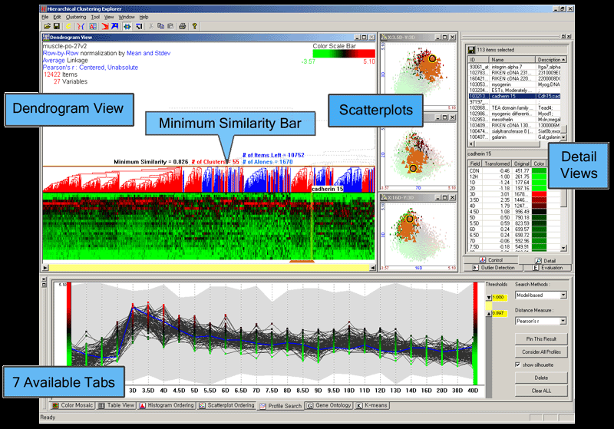
Hierarchical Clustering Explorer
Jinwook Seo, Ben Shneiderman, "Interactively Exploring Hierarchical Clustering Results," IEEE Computer, Volume 35, Number 7, pp. 80-86, July 2002

Slide 38
Rank-by-Feature Framework
What if we want to filter by similar features?
Provided a Minimum Similarity Bar which users can drag to change the similarity threshold level
Detail Cutoff Bar, subtrees below the detail cutoff level are rendered using only their average
Can also use our concepts of scagnostics again
Ranking histograms
Ranking scatterplots
Graphics, Ranking and Insight for Discovery
Study 1D, study 2D, then find features
Ranking guides insight, statistics confirms
Jinwook Seo and Ben Shneiderman, "Knowledge Discovery in High Dimensional Data: Case Studies and a User Survey for the Rank-by-Feature Framework," IEEE Transactions on Visualization and Computer Graphics, Vol. 12, No. 3, pp. 311-322, 2006

Slide 39
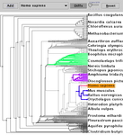
TreeJuxtaposer
Munzner, T., Guimbretiere, F., Tasiran, S., Zhang, L., & Zhou, Y. (2003). TreeJuxtaposer: Scalable tree comparison using Focus+Context with guaranteed visibility. ACM Transactions on Graphics, 22(3), 453–462.

Slide 40
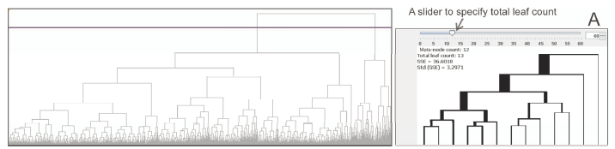
Constructing Overview + Detail Dendrogram-Matrix Views
http://www.youtube.com/watch?v=IRhKPpluwQ4
Jin Chen, Alan M. MacEachren, Donna J. Peuquet, "Constructing Overview + Detail Dendrogram-Matrix Views," IEEE Transactions on Visualization and Computer Graphics, pp. 889-896, November/December, 2009.

Slide 41
Hierarchical Clustering in R
http://blog.revolutionanalytics.com/2009/09/hierarchical-clustering-in-r.html

Slide 42
Readings and Homework
Required Reading:
Jinwook Seo, Ben Shneiderman, "Interactively Exploring Hierarchical Clustering Results," IEEE Computer, Volume 35, Number 7, pp. 80-86, July 2002
Jinwook Seo and Ben Shneiderman, "Knowledge Discovery in High Dimensional Data: Case Studies and a User Survey for the Rank-by-Feature Framework," IEEE Transactions on Visualization and Computer Graphics, Vol. 12, No. 3, pp. 311-322, 2006
Jin Chen, Alan M. MacEachren, Donna J. Peuquet, "Constructing Overview + Detail Dendrogram-Matrix Views," IEEE Transactions on Visualization and Computer Graphics, pp. 889-896, November/December, 2009.
Homework
Assignment #6 is due in 1 week.

